Slide 1
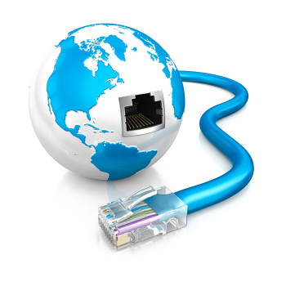
Internet Explained
SoftUni Team
Technical Trainers
Software University
https://softuni.bg

Slide 2
Table of Content
Introduction to Internet
How does the Internet work?
Packets - Sending and Receiving Information
Internet Protocol
Reliability and TCP
The OSI Model
Network Hardware
The Future of the Internet

Slide 3
Have a Question?
sli.do
#java-web

Slide 4

Introduction to Internet
An Introduction to the Internet

Slide 5
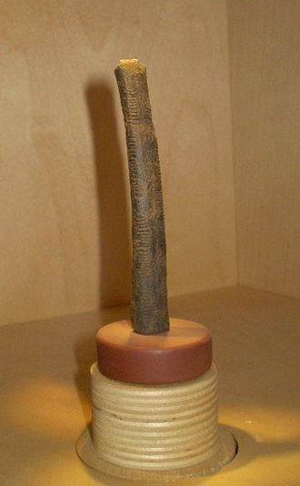
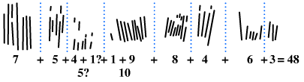
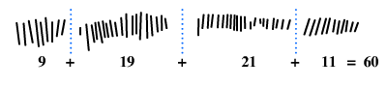
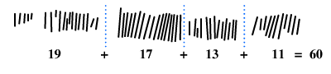
Ishango Bone
The Ishango bone is a bone tool and possible mathematical object, dated to the Upper Paleolithic era.
The etchings on the bone are in three columns with marks asymmetrically grouped into sets, leading hypotheses such as that the implement indicates an understanding of decimals or prime numbers

Slide 6
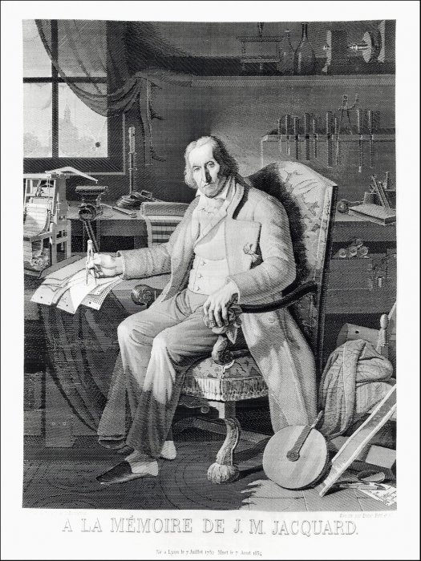
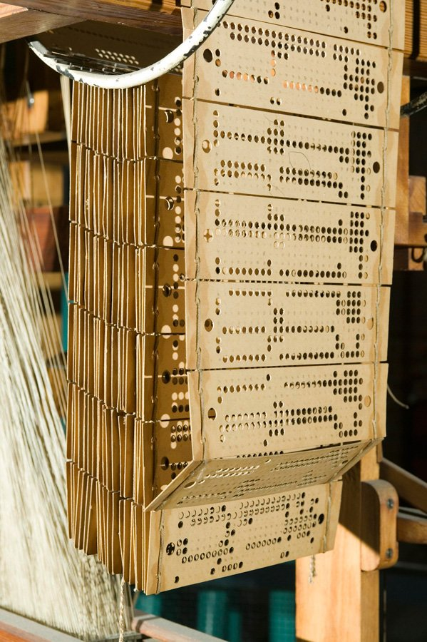
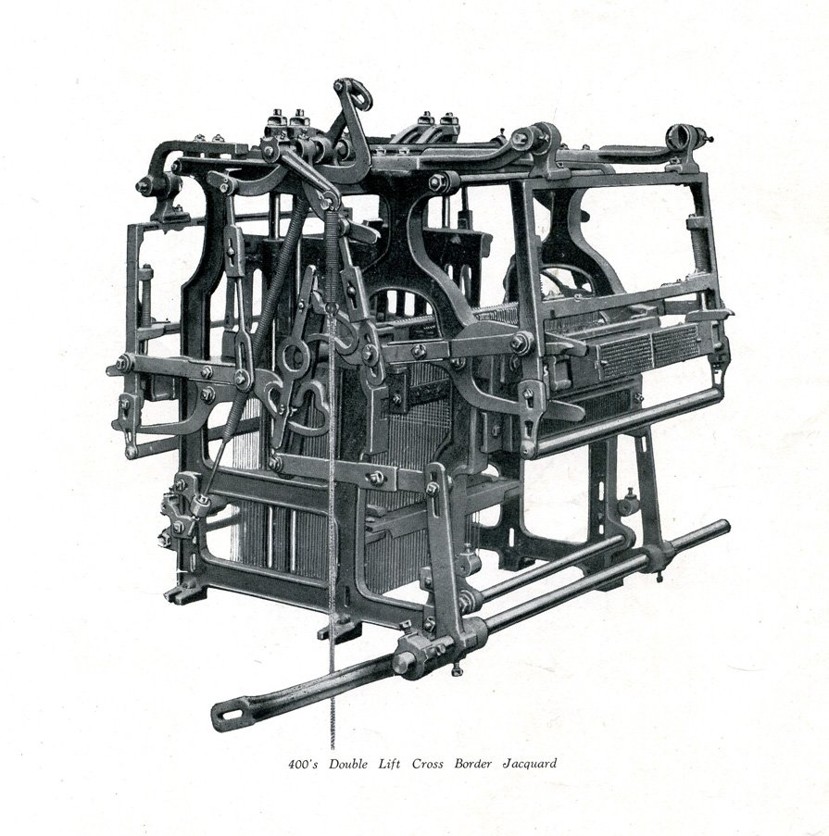
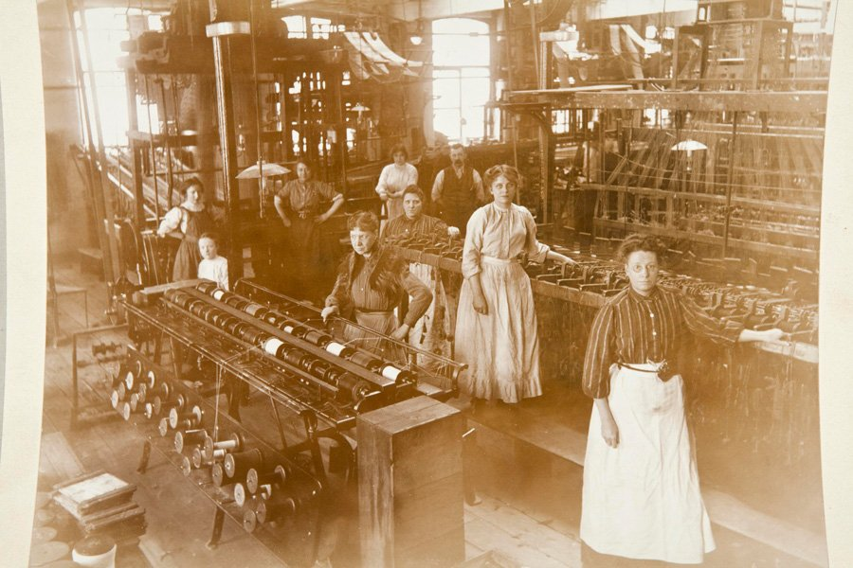
Jacquard machine
Joseph-Marie Jacquard, a French weaver and merchant, patented his invention in 1804.
Machine use of interchangeable cards, upon which small holes were punched, which held instructions for weaving a pattern

Slide 7
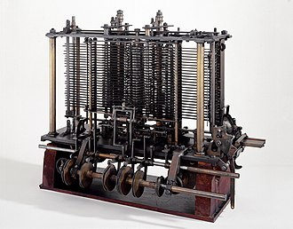
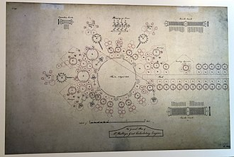
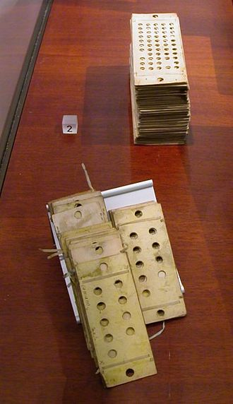
Analytical Engine
The Analytical Engine was a proposed mechanical general-purpose computer designed by English mathematician and computer pioneer Charles Babbage
The Analytical Engine incorporated an arithmetic logic unit, control flow in the form of conditional branching and loops, and integrated memory, making it the first design for a general-purpose computer that could be described in modern terms as Turing-complete

Slide 8
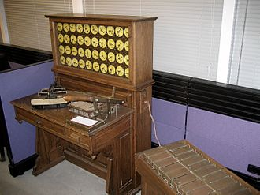
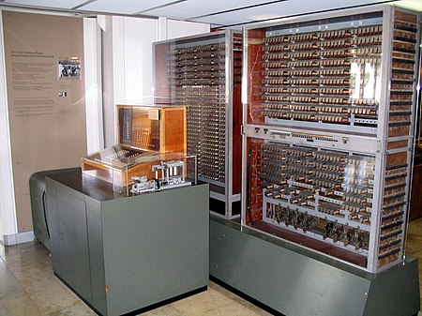
Tabulating machine & Z3
The Tabulating machine was an electromechanical machine designed to assist in summarizing information stored on punched cards.
Invented by Herman Hollerith
Later models were widely used for business applications such as accounting and inventory control
The Z3 was a German electromechanical computer designed by Konrad Zuse in 1935, and completed in 1941. It was the world's first working programmable, fully automatic digital computer.

Slide 9
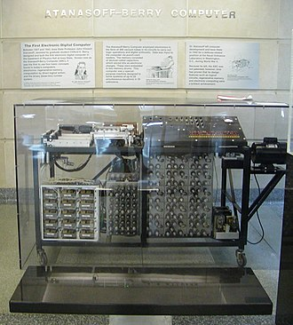
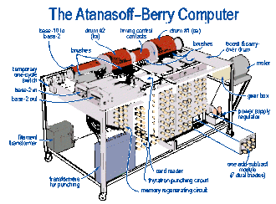
Atanasoff–Berry computer
The Atanasoff–Berry computer (ABC) was the first automatic electronic digital computer.
The ABC would be considered the first electronic ALU (Arithmetic Logic Unit) - which is integrated into every modern processor's design.
Its unique contribution was to make computing faster by being the first to use vacuum tubes to do the arithmetic calculations

Slide 10
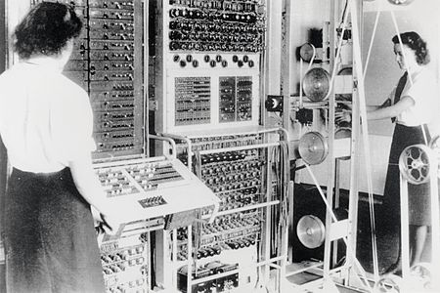

Colossus & ENIAC
Colossus was a set of computers developed by British codebreakers in the years 1943–1945 to help in the cryptanalysis of the Lorenz cipher.
Colossus used thermionic valves (vacuum tubes) to perform Boolean and counting operations.
Colossus is thus regarded as the world's first programmable, electronic, digital computer, although it was programmed by switches and plugs and not by a stored program.
ENIAC (Electronic Numerical Integrator and Computer) was the first programmable, electronic, general-purpose digital computer. It was Turing-complete and able to solve "a large class of numerical problems" through reprogramming.
Was designed and primarily used to calculate artillery firing tables for the United States Army's Ballistic Research Laboratory

Slide 11
Internet – History
Begins with the development of electronic computers in the 1950s.
Packet switching networks were developed in the late 1960
The internet protocol was developed in the 1970s
In the 1980s at CERN Tim Berners-Lee created the World Wide Web – the first website, linking hypertext documents into an information system, accessible from any node on the network

Slide 12
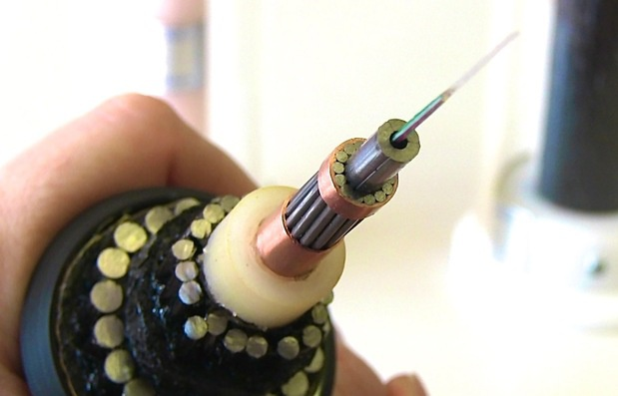
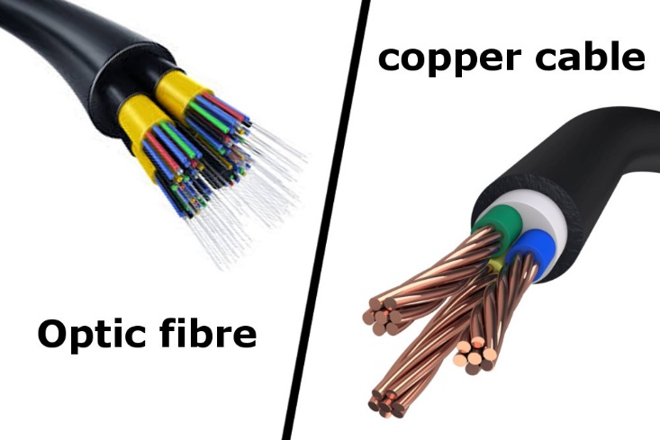
Internet – Introduction (1)
So, what is the Internet?
A simple answer to that question is a wire. A wire, which is buried into the ground or even in the ocean
That wire can be fiber optics, copper or occasionally beamed to satellites or through cell phone network

Slide 13
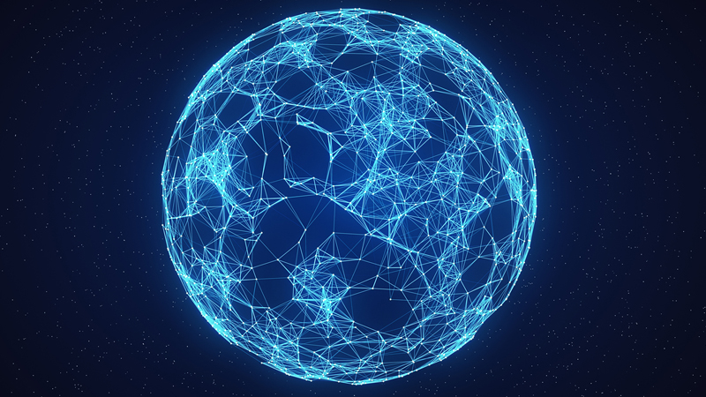
Internet – Introduction (2)
ISPs (Internet Service Providers) have access to such cables
We get indirectly connected to them though ISPs
The Internet is a network of networks. It connects billions of devices together all over the globe that are connected to this wire in one form or another

Slide 14
What is a Network?
Network - a group of two or more devices that can communicate
It is comprised of a number of different computer systems connected by physical and/or wireless connections
The scale can range from a single PC sharing out basic peripherals to massive data centers located around the World, to the Internet itself

Slide 15

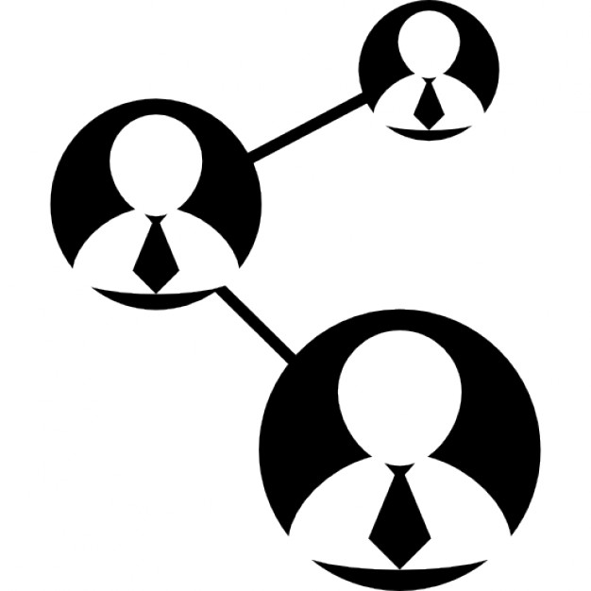

Networks and Internet
The internet is made of hundreds of thousands of networks and billions of computers and devices connected physically
These different systems connect to each other, communicate with each other and work together because of standards for how data is sent

Slide 16

How Does the Internet Work?

Slide 17



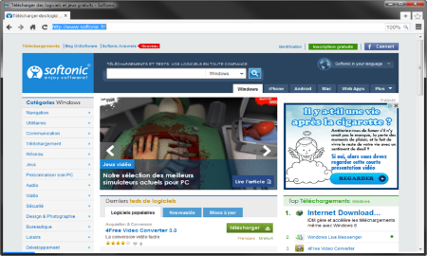





Web Server Work Model
Web Client
Web Server
Technology
Request
Response
Web Resources
Database
HTML, PDF, JPG…

Slide 18

Important Definitions
To understand how the Internet works, first we need to get acquainted with a few definitions
What is?
Server and Client
Network Protocol
Packets
TCP vs UDP

Slide 19

Servers and Clients
All of the machines on the Internet are either servers or clients
Servers are the machines that provide services to other machines
Clients are the machines that are used to connect to those services

Slide 20

Network Protocol
Network Protocol – a set of rules and standards, that allow communication between network devices
Network protocols include mechanisms for devices to identify and make connections with each other
Example for standard network protocols:
TCP, UDP, IP, ARP
HTTP, FTP, TFTP, SMPT, SSH

Slide 21
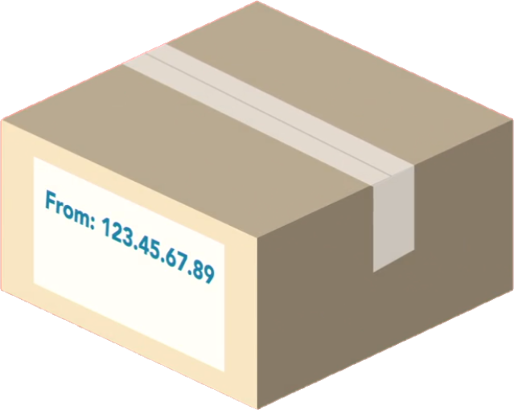
Packets
Sending and Receiving Information

Slide 22
Packets (1)
Everything that is created on a computer is translated into digital information using bits
Bits need to have a way to be transmitted over the internet
Every message, file or stream of information is broken down into small chunks called packets
When packets are sent on the internet, they usually travel the network together
But they might have to take a different route to get to the destination

Slide 23
Packets (2)
Each packet contains some important information inside of it called the header:
Where it came from
Where is it going
How long it is
This is how the packet is known to be complete
All the packets in the message are the same size
How many packets there are in the overall message

Slide 24
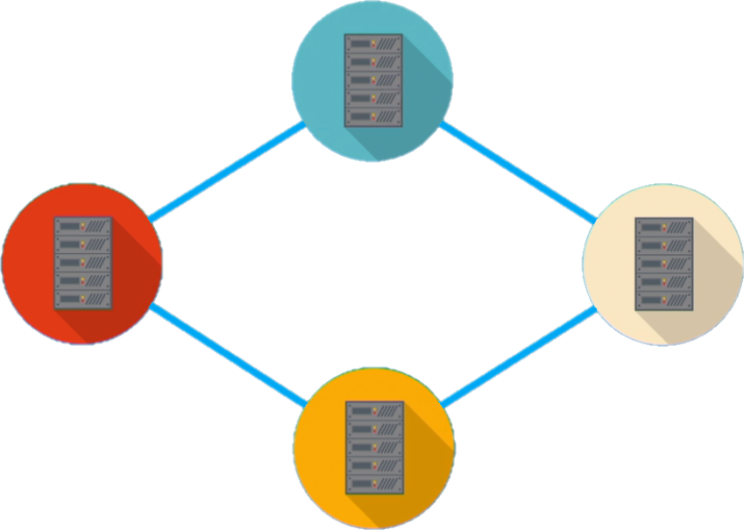
Traveling On the Packets in the Network

Slide 25
Internet Protocol
216.58.214.46
www.google.com
IPv4, IPv6 and DNS

Slide 26


Internet Protocol
One of the most important protocols used in Internet communication is the Internet Protocol (IP)
All the devices on the Internet have addresses
They are called IP Addresses
The IP address is unique to each computer or a device at the edge of the network
IP Address:
192.168.10.5
IP Address:
192.168.0.1

Slide 27
IPv4
IPv4 is a sequence of four, three-digit numbers separated by a period
Each number can be a number from 0 to 255
IPv4 is not enough for all network devices connected to the internet
In 1995, a new version of the internet protocol was created, it's called IPv6

Slide 28
IP Address
An IP Address has many parts, organized in a hierarchy
This version of IP Addressing is called IPv4
Provides more than 4 billion 32 bits unique addresses
Subnetworks
192.168.14.120
Device address

Slide 29
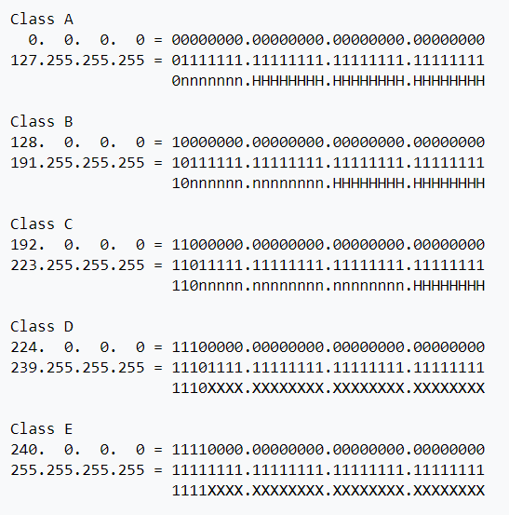
IP address classes

Slide 30
What Is CIDR (Classless Inter-Domain Routing)
Classless Inter-Domain Routing, is an IP addressing scheme that improves the allocation of IP addresses.
It replaces the old system based on classes A, B, and C.
This scheme also helped greatly extend the life of IPv4 as well as slow the growth of routing tables

Slide 31
IPv4 Private Address Space and Filtering
CIDR | IP address range | Class
10.0. 0.0/8 | 10.0. 0.0 – 10.255. 255.255 | A
172.16. 0.0/12 | 172.16. 0.0 – 172.31. 255.255 | B
192.168. 0.0/16 | 192.168. 0.0 – 192.168. 255.255 | C

Slide 32
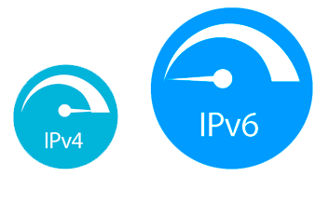
IPv6
IPV6 uses 128 bits - 340 undecillion unique addresses
That's more than the atoms on the surface of the Earth
These 128 bits are organized into eight 16 bit sections
Each 16 bit block is converted to hexadecimal and it's separated with a colon
This is a full IPV6 address:
3FFE:F200:0234:AB00:0123:4567:8901:ABCD
The leading zeros in IPv6 can usually be left out

Slide 33
What is a DNS?
www.softuni.bg
Domain name
The domain name is a human way to access IP addresses for devices and websites around the world
It is a sequence of phrases that map to a giant Internet-wide database of IP addresses
When a domain name is entered in the browser, a request is made to something called a DNS (Domain Name Server)
This server holds a cache of tons of domain names, and their matching IP addresses

Slide 34



DNS Example
request
IP Address | Domains
216.58.214.46 | Google.com
217.174.159.195 | Softuni.bg
https://softuni.bg
(217.174.159.195)
response

Slide 35
Reliability and TCP
TCP

Slide 36
Reliability
When packets are transmitted from one location to another, they can take different paths
When they get to the destination, they are unorganized and sometimes not complete
So the message needs to be audited and reviewed in order to put it together in the right way
The Transmission Control Protocol or TCP does exactly that

Slide 37

Transmission Control Protocol - TCP (1)
TCP uses a process, where it looks at all the packets in a message and checks them
Using the header information in each packet it knows:
How many there are
How large they should be
In which order the packets should be in
Using this checklist, it is able to rearrange the packets

Slide 38


Transmission Control Protocol - TCP (2)
If it finds that a packet doesn't match the expected characteristic, it is discarded
TCP has to verify that all the packets are:
In the right order
Free of any issues
After that it certifies the data and the packets are merged together to recreate the original file that was on the sender's device

Slide 39
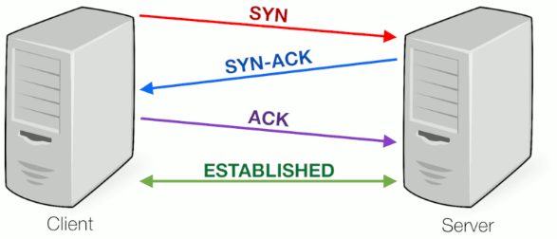
Transmission Control Protocol - TCP (3)

Slide 40
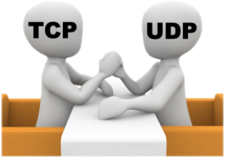
TCP vs UDP
TCP places reliability in a higher priority than speed or latency
For instances where reliability isn't as important, but speed is, there is another protocol called UDP or User Datagram Protocol
UDP doesn't do excessive reliability checks, but it can send information at a faster rate
TCP is the foundation of how a majority of data is transmitted over networks

Slide 41

User Datagram Protocol
UDP does not establish a session and it does not guarantee data delivery
It is known as the "fire-and-forget" protocol
It sends data and it doesn't really care if the data is received at the other end
Missing packets..
I don't care..
UDP

Slide 42
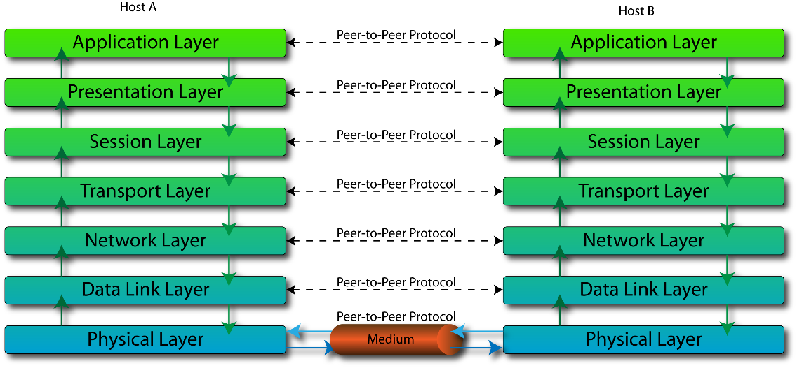
The OSI Model

Slide 43
What is the OSI Model?
OSI model stands for Open System Interconnect
It consists of 7 layers
Each layer serves the layer above it and in return, is served by the layer below it
Understanding each layer of the model helps us with:
Troubleshooting
Communicating better with technical and non-technical individuals about any system

Slide 44
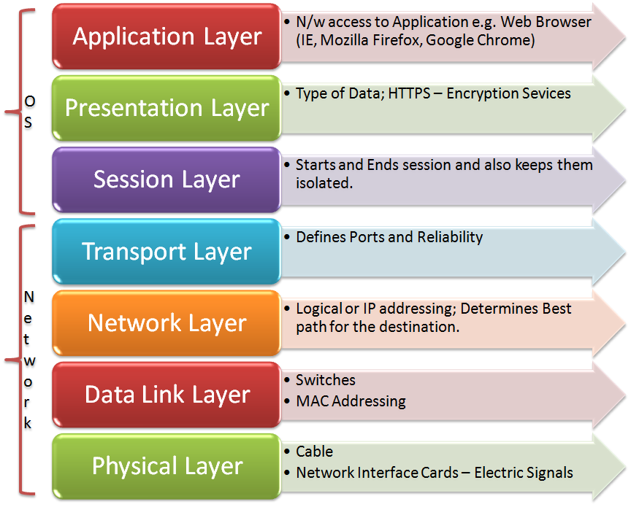
OSI Layers
OSI Model consists of 7 layers:
Example Protocols
HTTP, DNS, FTP, SMTP
TLS, SSL, compression
NetBIOS, PPTP, Sockets
TCP, UDP
IP, IPsec
ATM, Ethernet, MAC, LLC
USB, Bluetooth, 802.11a/b/g/n

Slide 45
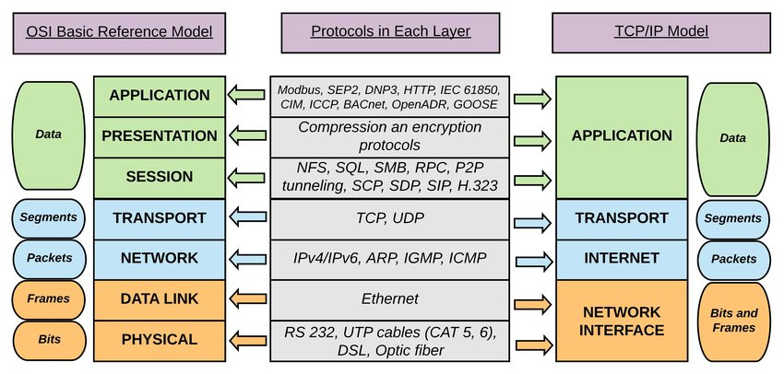
TCP/IP model mapping to OSI

Slide 46
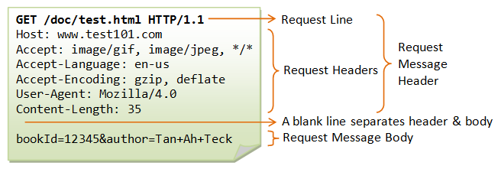
Application Layer – 7
Enables different applications like the browser to use the network and present it to the End User
Protocol examples:
Domain Name System (DNS)
File Transfer Protocol (FTP)
HyperText Transfer Protocol (HTTP)
Simple Mail Transfer Protocol (SMTP)

Slide 47
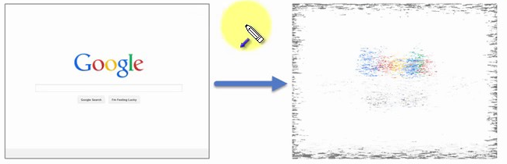
Presentation Layer – 6
This layer is a part of an operating system (OS)
Converts incoming and outgoing data from one presentation format to another
Example:
From clear text to encrypted (or compressed) text
Back to clear text

Slide 48
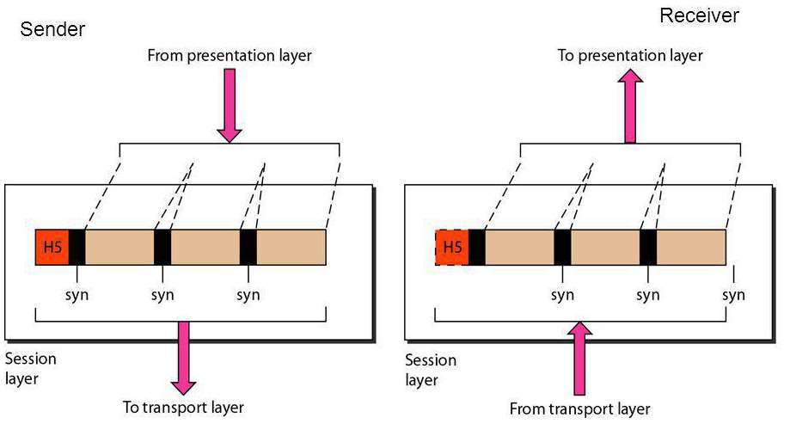
Session Layer – 5
This layer sets up coordinates and terminates conversations
Its services include authentication and reconnection after an interruption
e.g.: Sockets

Slide 49
Transport Layer – 4
Responsible for end-to-end communication over a network
Provides logical communication between application processes
Responsible for the management of error correction, providing quality and reliability to the end user
Protocol examples:
Transmission Control Protocol (TCP)
User Datagram Protocol (UDP)

Slide 50
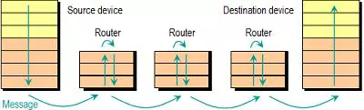
Network Layer – 3
Provides the functional and procedural means of transferring packets from one node to another
Responds to service requests from the transport layer and issues service requests to the data link layer
Protocol examples:
Internet Protocol (IP)
IPSec (IP + Auth)

Slide 51
Data Link Layer – 2 (1)
Provides node-to-node data transfer
It detects and possibly corrects errors that may occur in the physical layer
Divides into two sublayers:
Medium access control (MAC) layer - controlling how devices in a network gain access to a medium and permission to transmit data
Logical link control (LLC) layer – identifying and encapsulating network layer protocols, controls error checking and frame synchronization

Slide 52
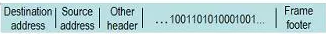
Data Link Layer – 2 (2)
Protocol examples:
Asynchronous Transfer Mode (ATM)
Ethernet
MAC

Slide 53
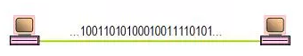
Physical Layer – 1
The things you can actually physically touch
Converts the binary from the upper layers into signals, transmits them over local media (electrical, light, or radio signals)
Examples:
Ethernet
USB
Bluetooth
802.11a/b/g/n

Slide 54
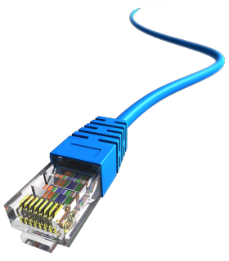
Network Hardware
Basic Hardware Components

Slide 55
Network Hardware
Basic Hardware Components
Cables
Routers
Repeaters, Hubs and Switches
Bridges
Gateways
Network Interface Cards

Slide 56
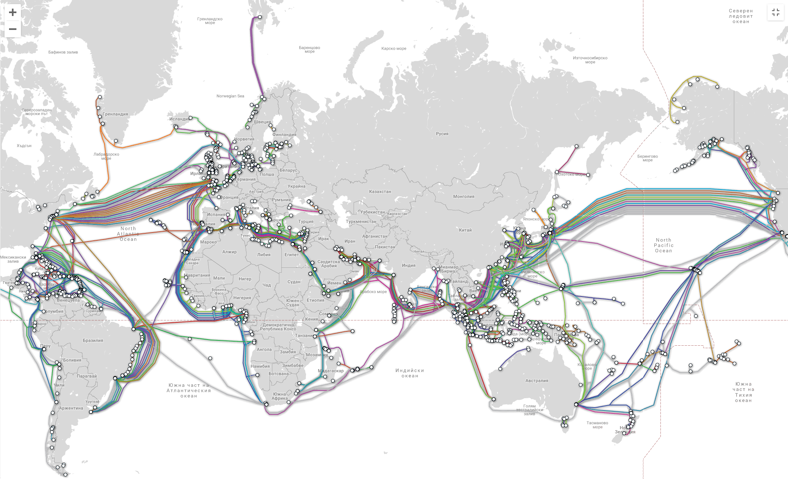
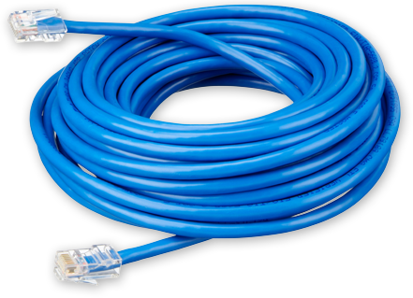
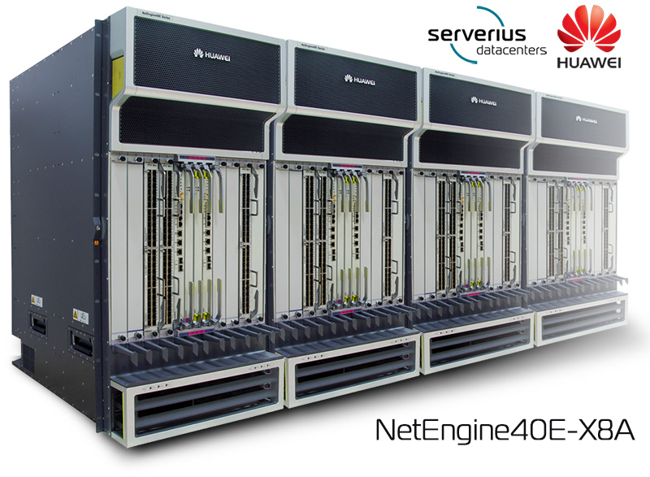
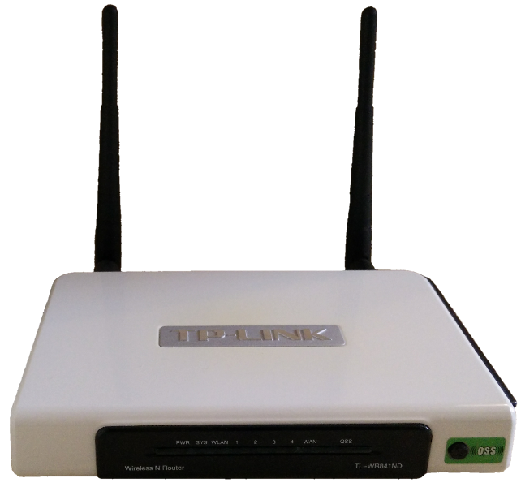
Cables and Routers
Network Cables – the transmission media to transfer data from one device to another
Router – connecting device that transfers data packets between different computer networks (operates on level 3 of OSI)

Slide 57
Repeaters, Hubs and Switches
Repeaters, hubs and switches connect network devices together so that they can function as a single segment
Repeater – receives a signal and regenerates it before re-transmitting, so that it can travel longer distances
Hub – multiport repeater (operates on level 1 of the OSI model)
Switch – receives data from a port, uses packet switching to resolve the destination device and forwards the data to the particular destination (operates on level 2 of the OSI model)

Slide 58
Bridges and Gateways
Bridge
Connects two separate but similar Ethernet network segments
Forwards packets from the source network to the destined network (operates on level 2 of OSI)
Gateway
Connects networks that work upon different protocols
The entry and the exit point of a network (controls the access to other networks)
Level 4, 5, 6 or 7 of the OSI model (same as Firewalls)

Slide 59
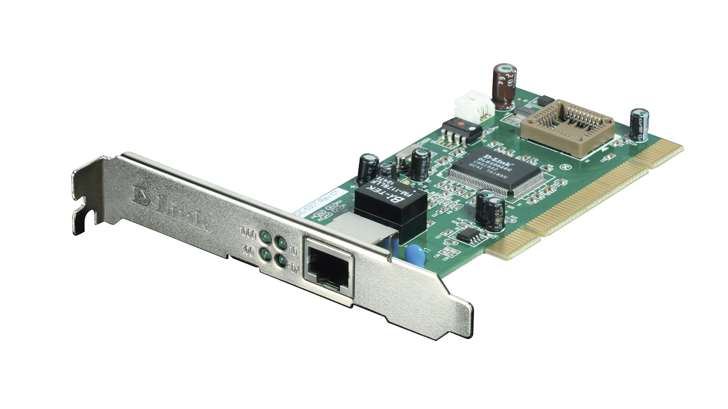
Network Interface Cards – NIC
NIC – a computer component that connects it to the network
There are two types of network cards:
Internal
External

Slide 60
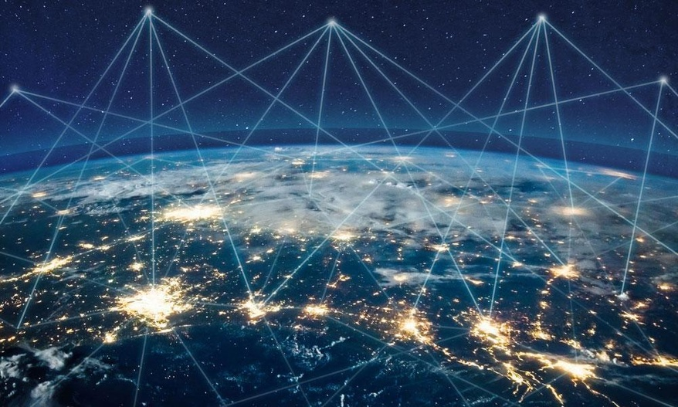
The Future of the Internet

Slide 61
The Future of the Internet
A typical modern home consists of: PC, Laptop, Tablet, Phones, TV, Security Camera, Air Conditioner, Smart Watch, Printer, Music Player, Light, etc.
The "Internet of Things" will expand
Healthcare, agriculture, wearables, manufacturing
Smart homes, cars and cities (pollution, parking, energy)
In 2030 there will be 50 billion devices connected to the Internet of Things

Slide 62

Summary
…
…
…
Internet, Definitions of Internet
Sending and Receiving Information
OSI model
Layers
Network Hardware
The Future of the Internet

Slide 63
Questions?
Notes:
63

Slide 64


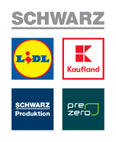









SoftUni Diamond Partners

Slide 65


Educational Partners

Slide 66
Trainings @ Software University (SoftUni)
Software University – High-Quality Education, Profession and Job for Software Developers
softuni.bg, about.softuni.bg
Software University Foundation
softuni.foundation
Software University @ Facebook
facebook.com/SoftwareUniversity
Software University Forums
forum.softuni.bg
Notes:
66

Slide 67

License
This course (slides, examples, demos, exercises, homework, documents, videos and other assets) is copyrighted content
Unauthorized copy, reproduction or use is illegal
© SoftUni – https://about.softuni.bg/
© Software University – https://softuni.bg
Notes:
67

